Slide 1
Fatigue Analysis and Prediction
in Rugby 7s
Team Not Alex Kim
Bucknell University
Alex Kim, Yash Mittal, Mateen Qureshi

Slide 2
Interpretation vs Prediction
Problem
→ Usually two or more games held on the same day with only a few hours of recovery
→ Cumulative effect of exercise load hard
Need
→ Optimal training program based on adequate balance
→ Prevent over-training
Therefore,
→ Interpretation and prediction of fatigue are integral
Source: Elloumi et al. Monitoring Training Load and Fatigue in Rugby Sevens Players.

Slide 3
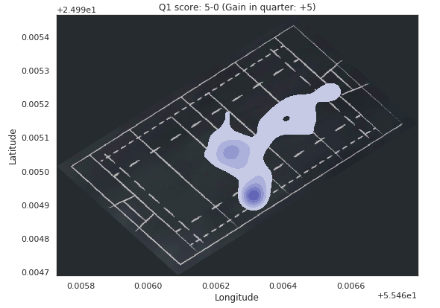
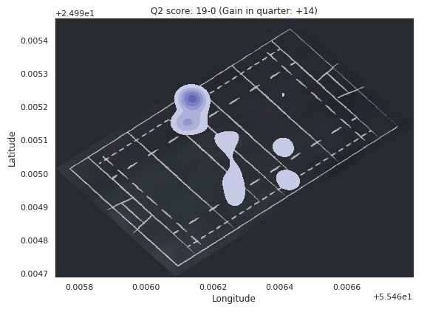
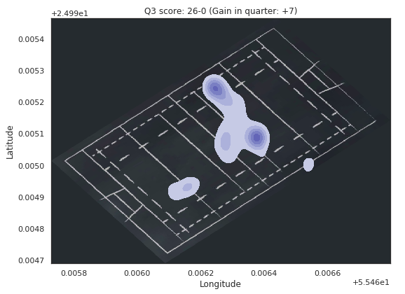
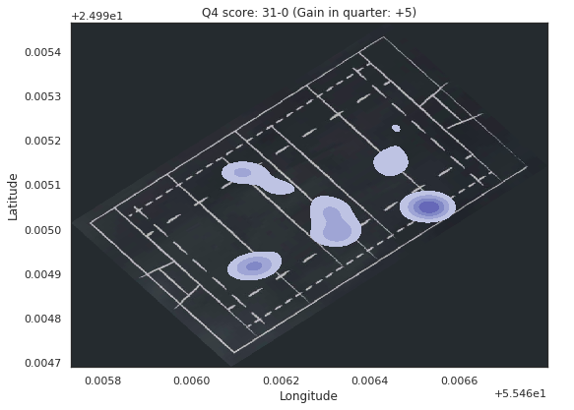
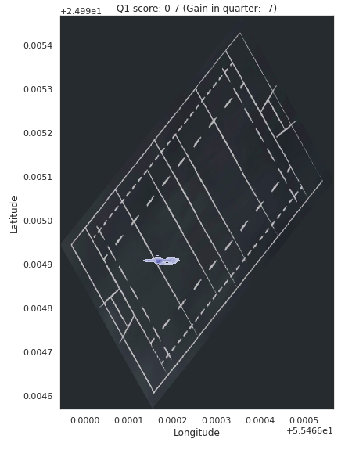
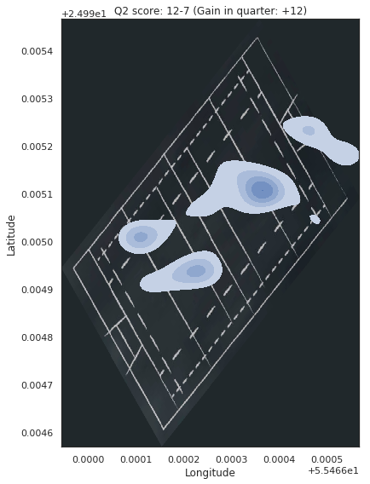
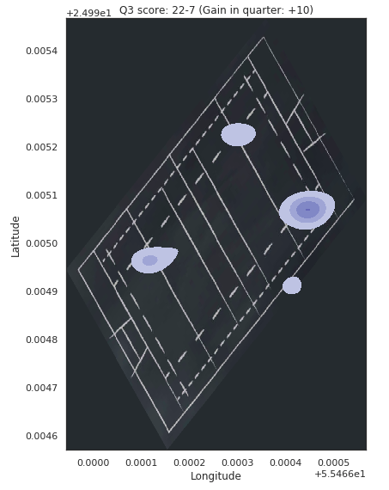
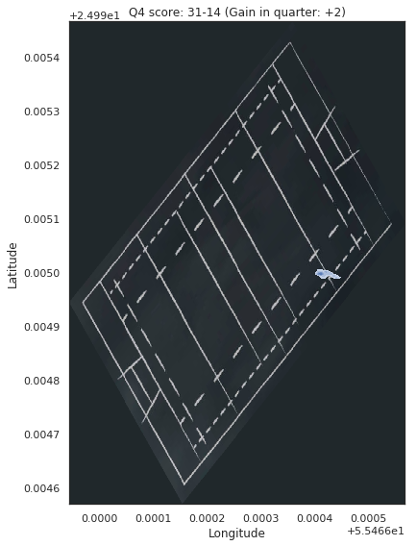
Interpretation: Heatmap (external data used)
PlayerID = 2
GameID = 2
+5
+14
+7
+5
Source: https://www.world.rugby/sevens-series
GameID = 3
-7
+12
+10
+2

Slide 4
Interpretation: Feature Selection
Wellness + Rate of Perceived Exertion (RPE) data for each day
Limitations
→ Not all of RPE data is matched up with gps data
Variables
→ Wellness (subjective): [0, 1] scale
→ RPE (objective): Z score scale
→ Previous day’s sessions data
Notes:
Wellness (subjective)
Soreness, desire, fatigue, irritability, sleep hours, sleep quality, menstruation, training readiness
RPE (objective)
Total session load, acute chronic ratio, daily load
Previous day’s sessions data
Session Types, Total session load, acute chronic ratio

Slide 5
Interpretation: Association Rule Mining
Association Rule mining is used to discover the relationship between the variables in wellness and RPE focused on Training session type
Rule # | Antecedents | consequents | Support | confidence
1 | Skills | Desire_high | 0.54 | 0.83
2 | Training_ readiness_low | Mobility / Recovery | 0.38 | 1.0
3 | Sleep_quality_low, Soreness_low | Game | 0.32 | 0.8
4 | Acute Chronic Ratio_Low | Desire_high | 0.32 | 0.83

Slide 6
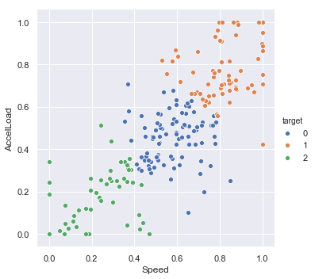
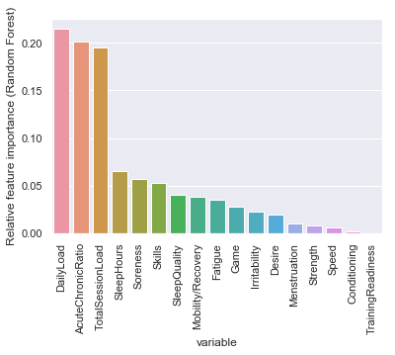
Prediction: Classification (Data Mining)
Cluster each player’s game data (Speed and AccelLoad) and group them
→ objective fatigue measurement (3 levels)
Build Machine Learning Models
→ Input : preprocessed data (18 inputs)
→ Output : 3 fatigue levels (0,1,2)
Results
 | Base | Decision Tree | Neural Nets | Random Forest
Accuracy | 0.33 | 0.42 | 0.52 | 0.78

